Slide 1

Submission and Review Process
Emily Redd
Publications and Special Projects Coordinator

Slide 2

Overview
Deadlines
Checklist
Uploading
Review
Editing Process
Final Approval
Notes:
* Details to come

Slide 3
Know Your Deadlines
ETSU Calendar: https://www.etsu.edu/calendar/
Graduate School:
https://www.etsu.edu/gradschool/default.php
Thesis and Dissertation:
https://www.etsu.edu/gradschool/etd/default.php
Know Your Resources

Slide 4
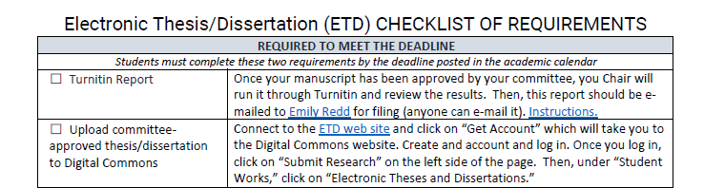
Checklist
What is required to meet the submission deadline?
Turnitin Report
Upload of Committee-approved thesis/dissertation

Slide 5
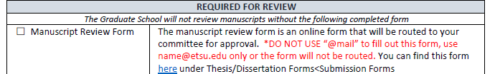
Required for Review
Manuscript Review form
You will be added to the list to review, but the review will not begin until your committee Chair has signed
You will be notified when it has been completed
A copy is sent to me, Emily Redd via email
Notes:
* Details to come

Slide 6
Manuscript Review form cont…
If you have a committee member outside the university, they will not be able to log in so, enter my information and I will contact them separately: Emily Redd redd@etsu.edu
Manuscript Review form release options:
Unrestricted – upon approval, worldwide access
Embargo – upon approval, 1 year embargo
Restricted – upon approval, no access without ETSU credentials (rare)

Slide 7



Continuing the Submission Process
Follow the Checklist of Requirements to be sure you turn in all remaining items and complete all requirements that apply to you

Slide 8

Other Requirements
ProQuest Agreement
IRB closure memo, if applicable
Survey of Earned Doctorates, if applicable
Alternate format journal article permissions
Notes:
IRB: confidentiality of subjects – don’t give too many details or acknowledgements

Slide 9
The Review Process
Format check – Style Guide Blend
Graduate School Thesis and Dissertation Guide
General guidelines for formatting all ETSU theses and dissertations
Template: Title page, abstract, table of contents, lists of tables/figures, vita
Departmental Style Guide
APA, ACS, CSE, ASA, AMA, MLA, Turabian, Chicago, LaTex

Slide 10

The Review Process Cont.
Grad School general guidelines
Use the templates!
Margins: at least 1 inch on all sides
Use a standard font and font size throughout
Pagination: page numbers (2, 3, 4) centered at the bottom of each page
No running headers
Abstract – unindented paragraphs
150 words for theses
350 words for dissertations
Vita (limit to 2 pages of the most recent and relevant information)

Slide 11
Standard Format
Organization of the Manuscript:
Title page (no page number)
Abstract (page 2)
Copyright page (if desired)
Dedication page (if desired)
Acknowledgments (if desired)
Table of Contents
List of Tables (if you have more than 5 entries)
List of Figures (if you have more than 5 entries)
Body of Manuscript
Bibliography / References / Works Cited
Appendix / Appendices ***NO IRB FORMS***
Vita

Slide 12
Alternate Format
Chapter 1 – Introduction including statement of hypotheses
Chapter 2 – One journal article for a thesis, or a series of journal articles for a dissertation, presented as separate numbered chapters. These articles should be in the format they would be when published (figures in the body of the text not at the end) and include an abstract and references.
Chapter 3 – Dissertations must have a final summary chapter. A thesis advisory committee may request this but it is not required.
Tables and Figures are to be numbered by chapter (1.1, 1.2, 2.1, 2.2, 2.3, 3.1, 3.2, etc.)

Slide 13
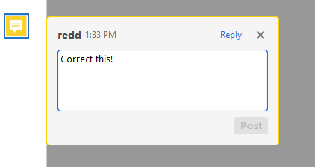
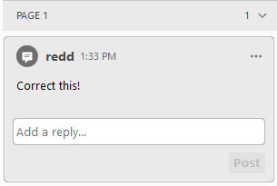
Editing
For the format review:
“Sticky” notes will be made in your PDF file and sent back to you via e-mail
Make your corrections in your Word (or other) file, convert back to PDF, and resubmit via the web site
You should expect at least two rounds
How quickly you get finished depends on when you submit, if your paperwork is all in, and how many corrections are needed

Slide 14

Final Approval
The Dean or Associate Dean will look over the final manuscript for approval
Automated e-mail will be sent once approval has been processed
Must have approval before the final deadline to graduate

