Slide 1

Intelligent Package Delivery System
Don McCarty
Manager Postal Service
East Tennessee State University

Slide 2
Purpose of Presentation
Educate - “What is it”
Explain ETSU Concept
Highlight Simplicity & Features
Show Basic Operation
Advantages for Students & Staff
Pick-up Technology
What’s Ahead

Slide 3
What is it?
Intelligent Package Delivery System
  A Secure Locker Storage System
  A Complete System Incorporating a State of the Art Electronics to Operate the Loading & Delivery
  Provides Automated Package Notification, Reminders and Delivery Verification

Slide 4
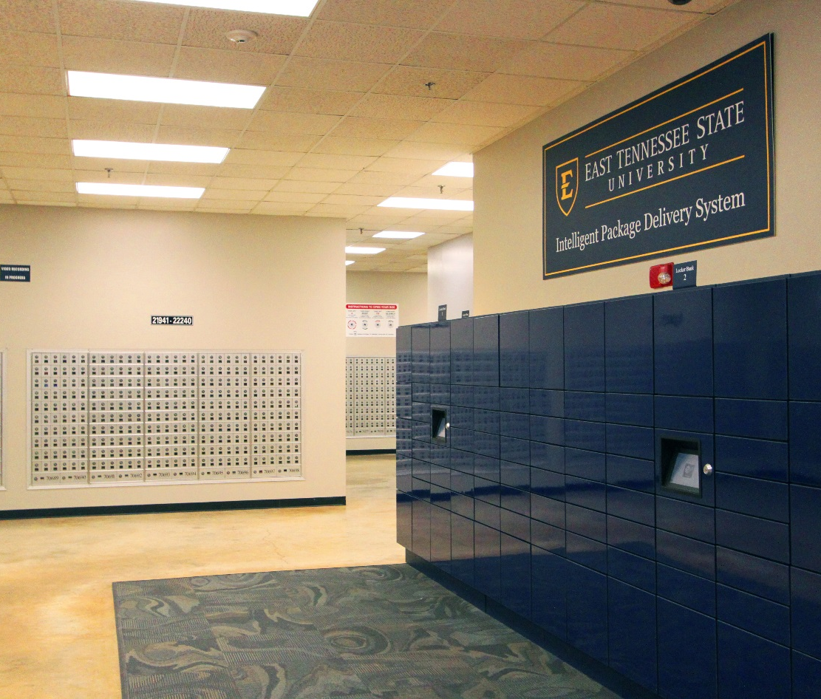
Intelligent Package Delivery System
144 Delivery Doors
3 Separate Computer Touchscreens
3 Battery Back-ups

Slide 5
System Requirements
Lockers & Computers
Internet Access &Virtual Server
Power Outlet
Student File with Name, Box #, Email
Email (example: postal@etsu.edu or etsu.postoffice@gmail.com)
Determine standard messages to be used

Slide 6
Our Concept of Operation
System installed in our Lobby
  Quick and Easy Access to Load & Reload
  Load in morning, before lunch, after lunch & before leaving if needed
  Protected from Elements, Monitored by Camera & Observable from our Counter
4 Different Door Sizes Maximizes Delivery
Removed after 2 School Days (it excludes weekends)

Slide 7
Features
Delivery is Completely Secure
  Every Function & Step is Recorded
  Complete Audit Trail
  Report Generation by Date
  Automated Daily Activity Report

Slide 8
Features
Notifications
  Customer Immediately Notified upon Drop-off
    Notification by Email (could also be SMS)
  Customer Receives Delivery Verification Email
  System Sends Auto Reminders & Expired Notices

Slide 9
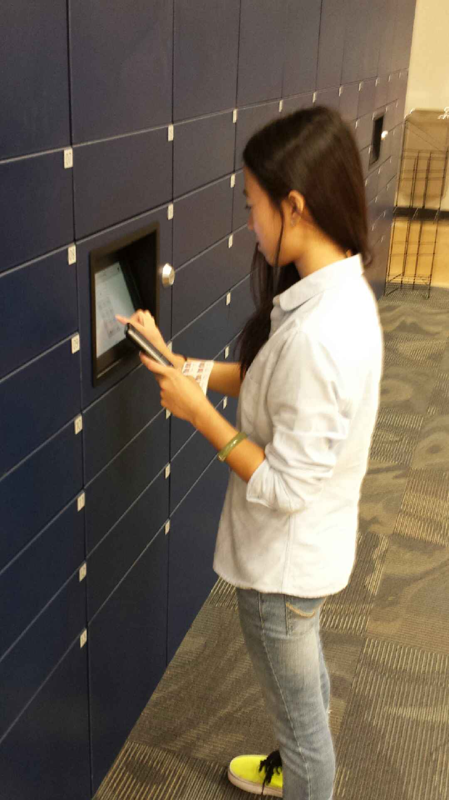
Pick-ups Are Easy!
Secure
Monitored

Slide 10
Package Pick-up Sequence
Touch Screen
Enter 5 Digit PIN
Door Opens
Remove Package & Close Door
Delivery Verification Email Sent

Slide 11
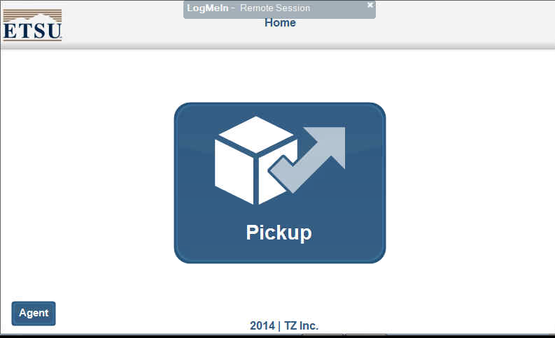
Pick-up Screen – Step 1
Press “Pickup” Icon

Slide 12
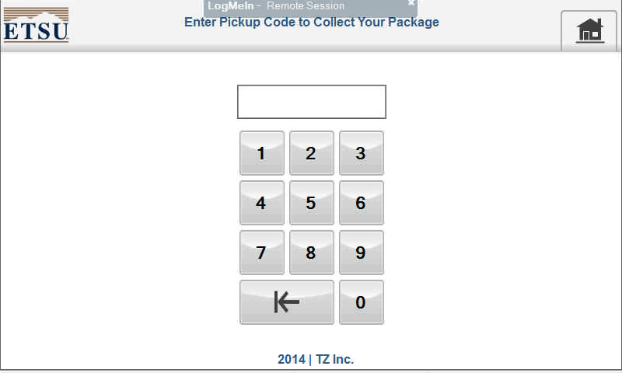
Pick-up Screen – Step 2
Enter “5 digit PIN“ & Correct Door Opens Automatically!

Slide 13
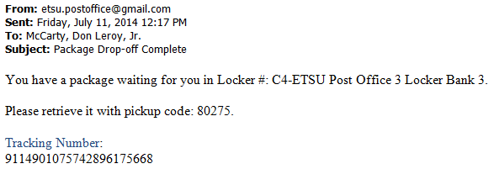
Package Drop-off Notification
Successful Pick-up Email Notification

Slide 14
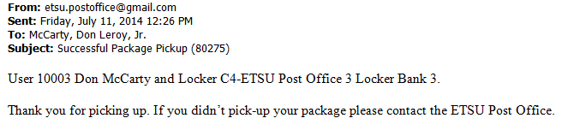
Successful Package Pickup Verification

Slide 15
Advantages - Students
Convenience
  Students only need 5 Digit PIN or Student ID
  Access is 20/7 but could be 24/7
  Weekend & Holiday Access
  No Waiting in Lines
  Average 1 Expired Package Per Day

Slide 16
Advantages - Staff
One Time Handling by Staff
Super Simple to Load & Update
Eliminates Need for Shelf or Storage Space
Tripled Delivery Access Time but didn’t add Staff or Hours
We have shifted scanning & window delivery to new additional duties

Slide 17
Locker Loading Sequence
Select
“Drop-off”
Select
“Package Size”
Enter “Student Box Number”
Scan Package Barcode
Door Opens
Place Package in Locker
Close Door
Email Sent

Slide 18
Logon Screen – Step 1
Select “Agent“ Button

Slide 19
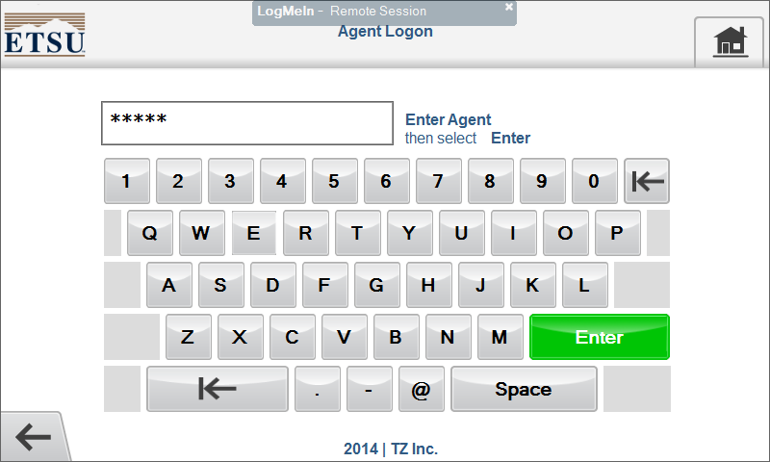
Logon Screen – Step 2
Enter “Logon Name“ & Press “Enter”

Slide 20
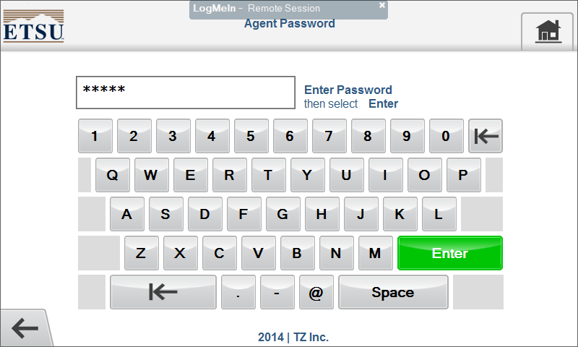
Logon Screen – Step 3
Enter “Password” & Press “Enter”

Slide 21
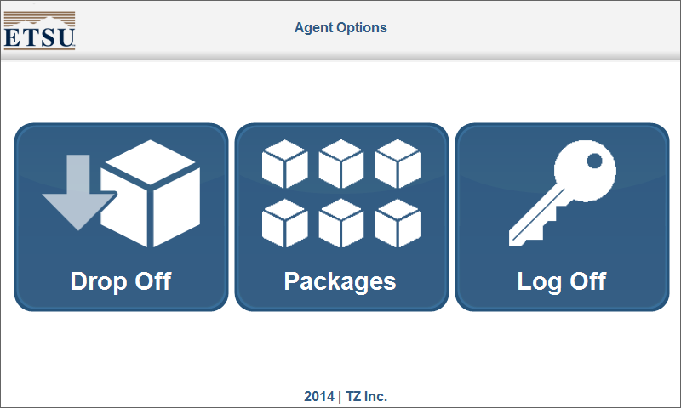
Locker Drop-off Screen – Step 1
Select “Drop Off” Button

Slide 22
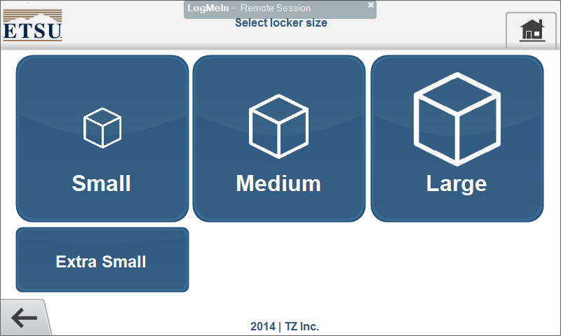
Locker Drop-off Screen – Step 2
Select the needed Size

Slide 23
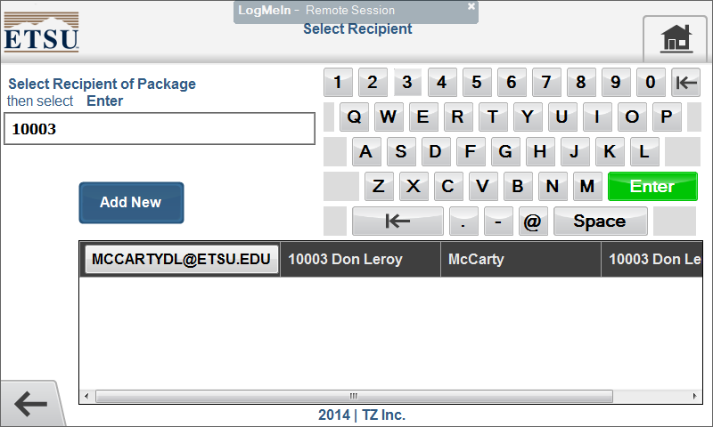
Locker Drop-off Screen – Step 3
Enter “5 Digit Box Number or Name” & Press “Enter”

Slide 24
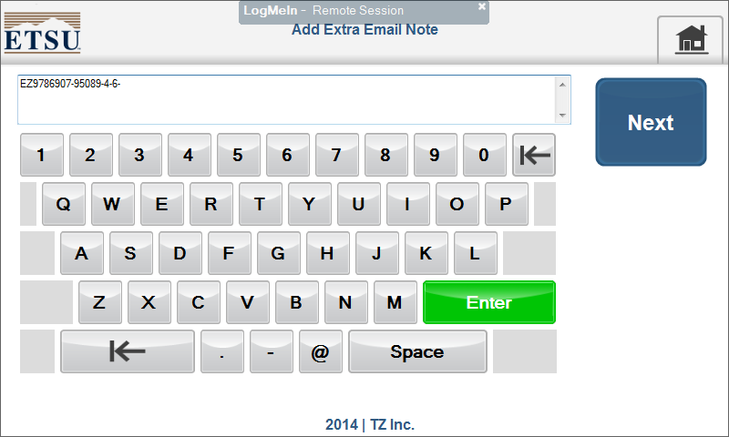
Locker Drop-off Screen – Step 4
Scan “barcode” with the Scanner & Press “Next”

Slide 25
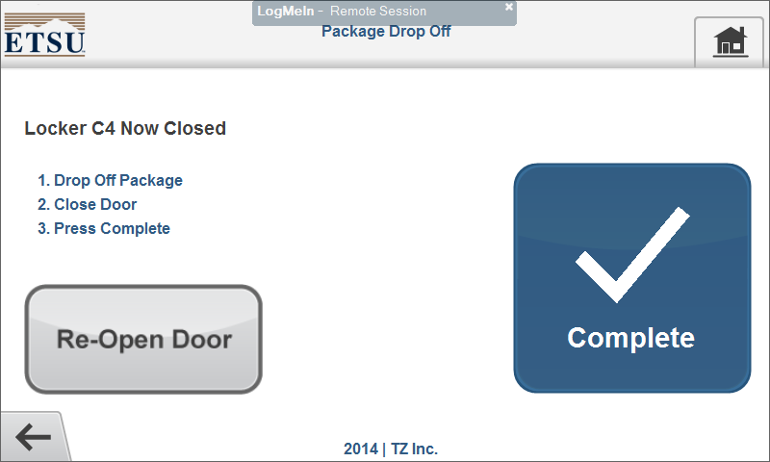
Locker Drop-off Screen – Step 5
1. Drop Off Package 2. Close Door 3. Press “Complete”
Repeat Steps 1-5

Slide 26
Locker Drop-off Admin Access
Admin Account Allows for Total Control of System
  Adding Users, Agents and Additional Admin Accounts
  Provide Maintenance, Change Locks & Open Doors
  Control Settings such as:
    Email Address, Notification Frequency & Internet Access
  Generate Usage Reports
  View which Lockers are in Use or Vacant
System can be accessed and changed remotely

Slide 27
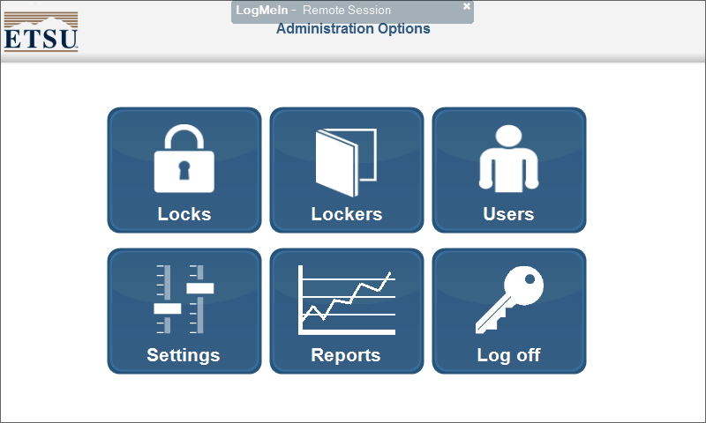
Admin Screen Controls Almost Everything

Slide 28
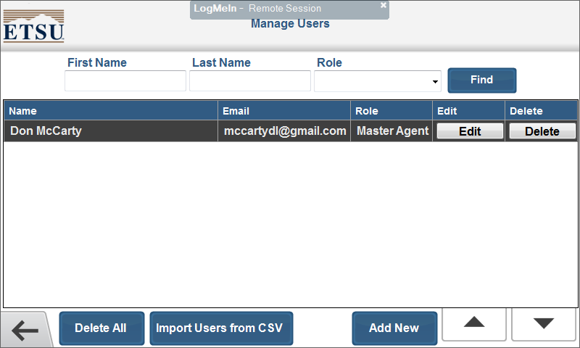
Add Users & Agents Manually or Import

Slide 29
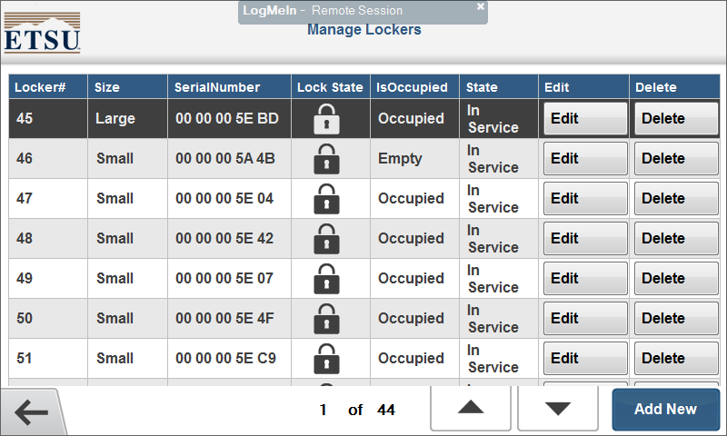
Manage Locker Door Maintenance

Slide 30
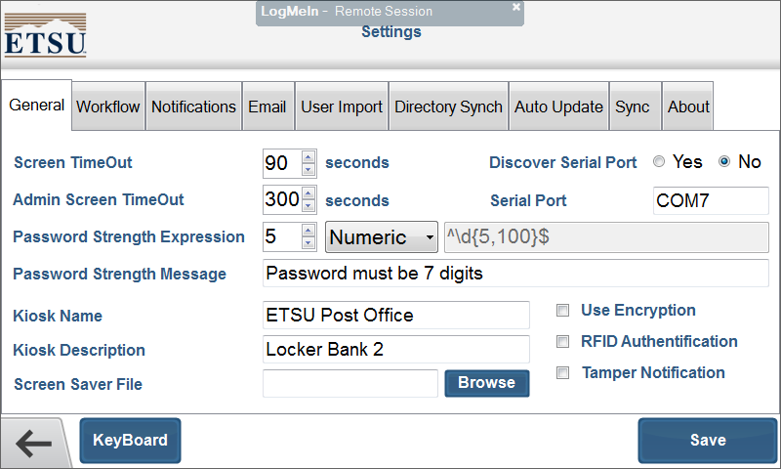
Adjust Various Locker System Settings

Slide 31
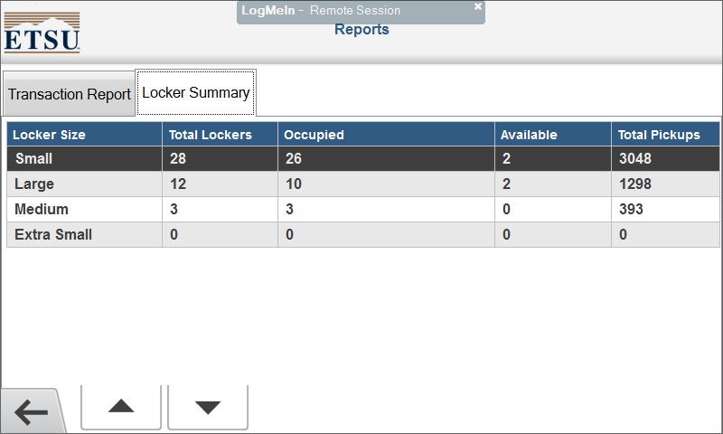
Generate Current or Previous Usage Reports

Slide 32
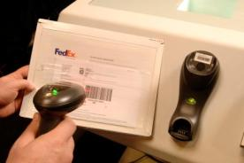
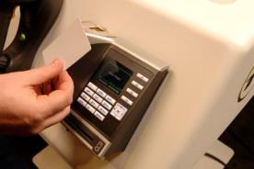
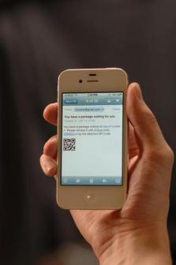
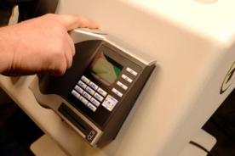
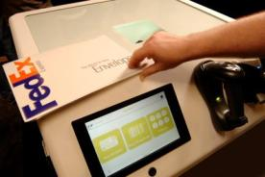
Wide Range of Technology Options
Barcode Scanner
RFID Scanner
QR Code
Biometric Authentication
OCR Scanner

Slide 33
ETSU Numbers
Average Drop-off to Pick-up Time - .51 day
Number of Packages that weren’t able to go into the lockers per day – less than 1
Average Pickups after 3:55 pm – 53
Average Pick-ups Per Weekend (Sat & Sun) - 34
Most Deliveries in One Day – 246 (141 Doors)
Average Total Time Per Day to Load Lockers up to 4 times per day – 1.0–1.5 hours

Slide 34
Customer Reaction
  Overwhelmingly Positive
  Students report “They just Love availability for Late Evening and Weekend pick-ups”
  “So Cool!” Most common reaction
  Administration has enjoyed the positive press in Press & TV
  Parents on tours think it is great

Slide 35
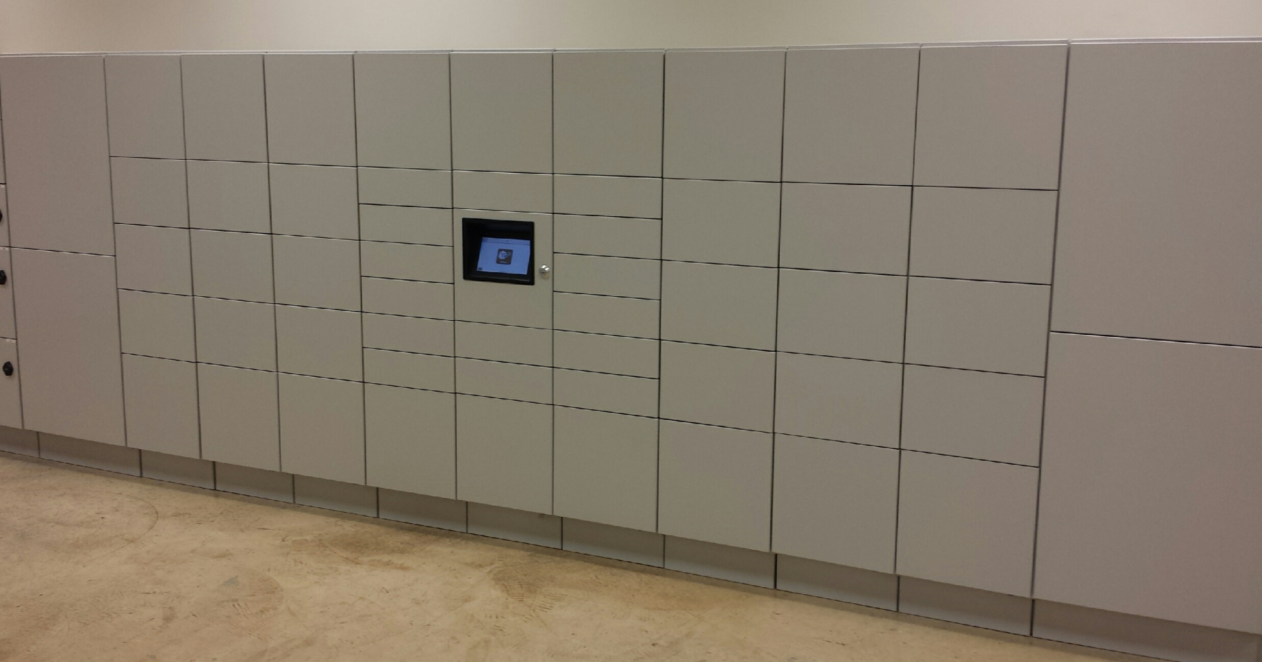
Newest Locker Additions

Slide 36
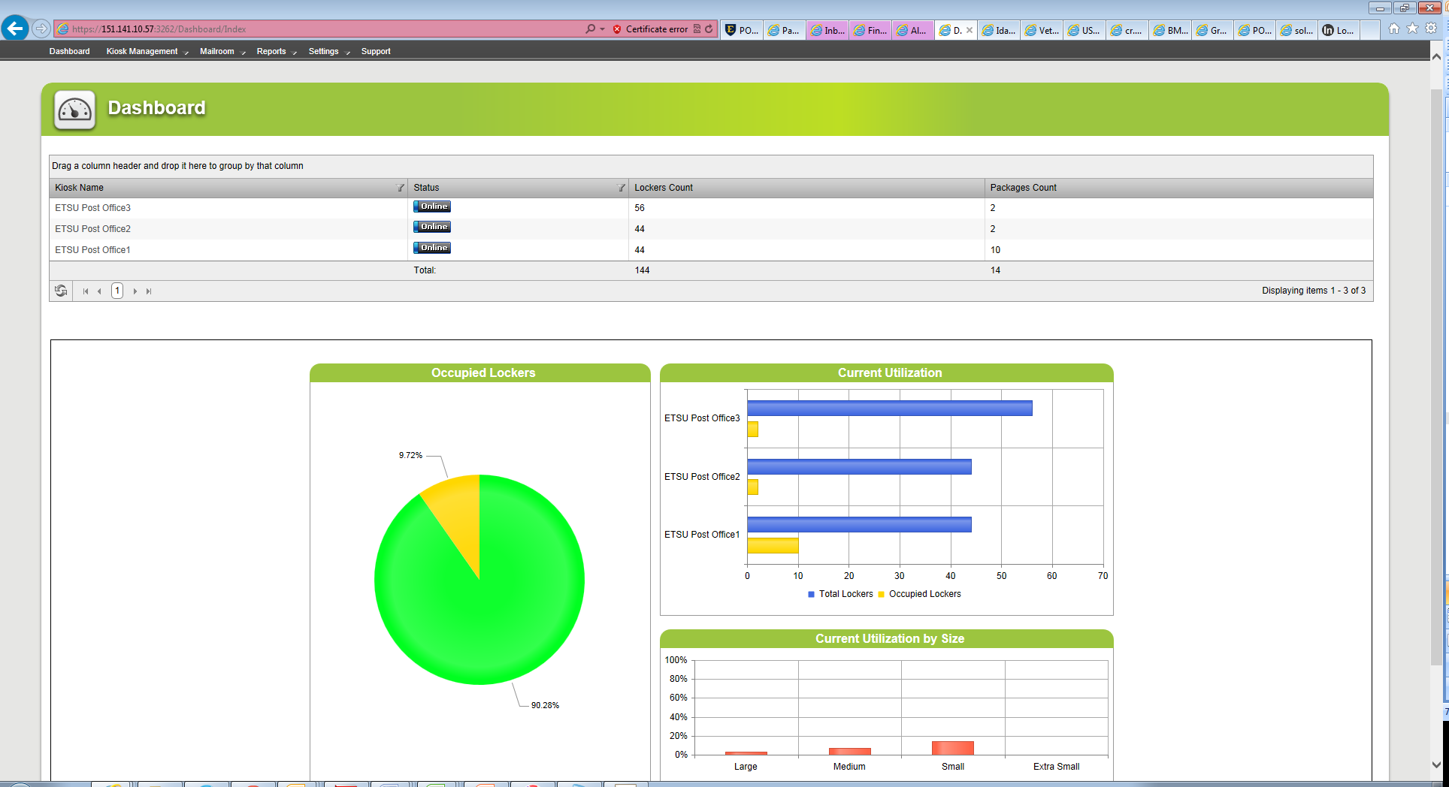
Asset Manager Dashboard

Slide 37
Intelligent Package Delivery System
Questions?
Don McCarty
Manager Postal Service
East Tennessee State University
423-439-6895
mccartydl@etsu.edu

